Slide 1
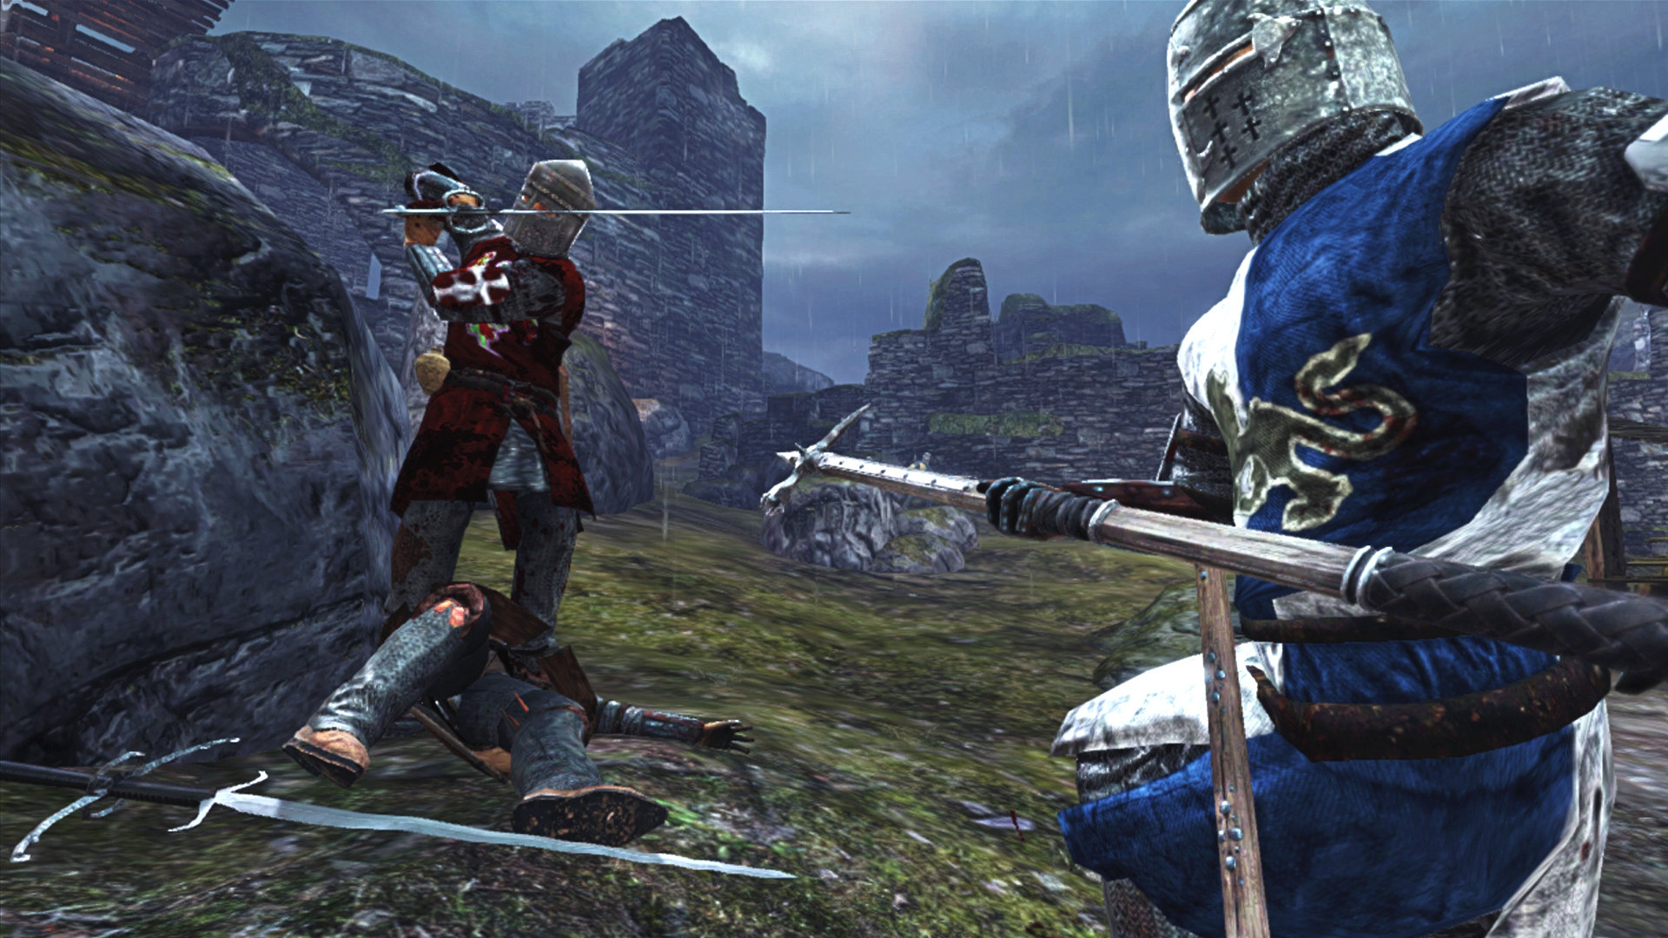
LONG
Knights
Choose
Thy Own Path
Text Based
Adventure Game
By
Paige Sanford
&
CASTLE DAZE
Attributions to Shannon Jones and Sydney Elledge and
An Unfortunate Fright Night Repository

